Slide 1
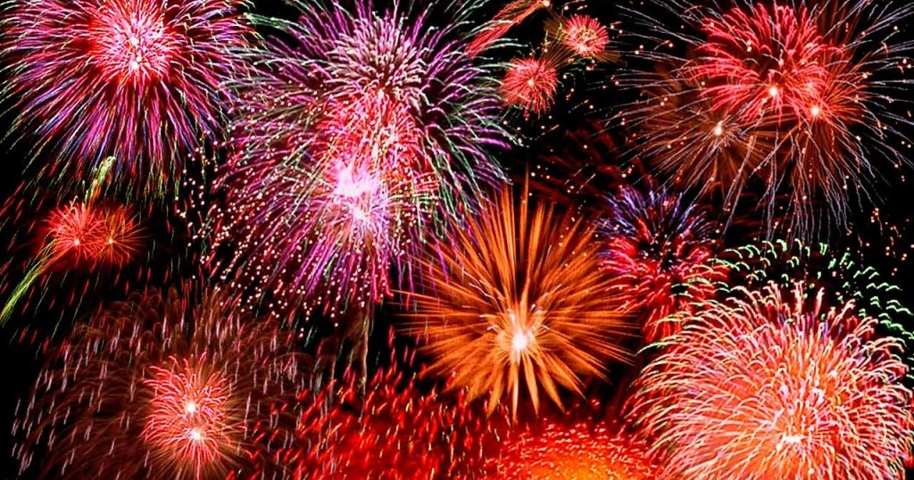
Greater Lake County Hall of Fame Members
1988 |  | 1989 |  | 1990 |  | 1991
Mary Jane "Jake" Browne |  | Mary Gleason |  | Lois Hartman |  | Judy Donat
Velma Johnson |  | Marge Merlo |  | Irene Russell |  | Gert Emrick
Jennie Robinson |  | Cecelia "Curly" Wertz |  |  |  | Karyl Moeller
1992 |  | 1993 |  | 1994 |  | 1995
Karen Fox |  | Roy Bertrand |  | Abe Davis |  | Sandra Barkley
Beatrice Herrick |  | Violet "Vi" Castellari |  | Sandy Pangratz |  | Sidney Hills
Myrt Stauche |  | Wendy Esp |  | John Ryan |  | Alby Lenarsic
 |  | Audrey Herberger |  | Fay Veltum |  | John Picchietti Sr.
 |  | Nick Hubert |  | Don Voight |  | Grace Platt
 |  | Robert Kennedy |  |  |  | Joseph Sterbenz
 |  | Phil Sikoff
 |  | Edward Zelesnik

Slide 2
Greater Lake County Hall of Fame Members
1996 |  | 1997 |  | 1998 |  | 1999
Dick Baker |  | August Edholm |  | Ron Blomberg |  | Sandy Kelley
Tony Cavalier |  | Mary Frank |  | Ruth Harris |  | Harry Lauritsen
Robert Dewitt |  | Abe Johnson |  | Kimmie Hucker |  | George Lawrence
Sue Hallwas |  | Ruth Lange |  | Evelyn Jereb |  | Joseph Piagentini
Helen Lange |  | Betty McCann |  | Jim Servis |  | Betty Servis
George "Rusty" O'flaherty |  | Rene'e Reitmayer |  |  |  | William Spigner
Pamela Seremak |  | Rony Russell
Donna Sternberg

Slide 3
Greater Lake County Hall of Fame Members
2000 |  | 2001 |  | 2002 |  | 2003
Ron Axberg |  | Anthony Cariello |  | Russ Bain |  | Curtis Aemisegger
Pat Cornell |  | Robert English Jr. |  | Robin Graham |  | Thomas Bertrand
Susie Grimes |  | William Graham |  | David Greenup |  | Pat Christensen
Renee Mongeau |  | Donna Rosenberg |  | Marge Janiskowski |  | Ellen Hansen
Eugene Payne Sr. |  | Betty Schneider |  | Jennifer Litewski |  | John Kerpan
Robert C. Rosengren |  |  |  | Allan Markle, Ph.D.
Judy Wentz |  |  |  | John Miller
 |  |  |  | Cornelius Van Fleet
 |  |  |  | Carol Voight

Slide 4
Greater Lake County Hall of Fame Members
2004 |  | 2005 |  | 2006 |  | 2007
Marlene Neuman |  | Georgia Bizzell-Jones |  | Michael J. Cohns |  | Michael Jacobs
Peggy Rommel |  | Marlene Brooks |  | Gloria Hanson |  | Gregory Olsen
Lana Schwab |  | Caryn Evitts |  | Linda Johnson |  | Patricia Piwowarcyk
 |  | Peter (Flip) Flaminio |  | Richard (Dick) Larsen |  | Linda Ryder
 |  | James Gochis |  | Dee McHugh |  | Joseph Pregrocki
 |  | Orin Hapke |  | Rich Newland |  | Charles "Chuck" Sosebee
 |  | Merilee Miller |  | Ward Taylor
 |  | Davey Rosen

Slide 5
Greater Lake County Hall of Fame Members
2016 |  | 2017 |  | 2018 |  | 2019
Marv Anderson |  | Ken Barton |  | Wendy Artman |  | Bob Anderson
Dean Bakkum |  | Angie Cevallos |  | Larry Claeys |  | Rich Blake
Mary Barclay |  | John Eifert |  | Jim Erickson |  | Rob Cunningham
Kevin Bell |  | Cindy Gerjol |  | Jodi Gross |  | David Hallwas
Nikki Hallwas |  | Robin Stewart |  | Michael Hall MD. |  | Mike Henninen
Mike Steil |  |  |  | Sharon Jennings |  | Eli Johnson
 |  |  |  | Pam Klask
 |  |  |  | Gabriel Rodriguez
 |  |  |  | Jamie Sensabaugh
 |  |  |  | Jim Stanczcak
 |  |  |  | Roger Zuchowski

Slide 6
Greater Lake County Hall of Fame Members
2020
Brenda Corenell
Wayne Thoma
Bob Romani
Kirk Reusch
Hal Erickson
Wally DeThorne

